Slide 1

Student Attendance System
A Python-based GUI Application for Efficient Management

Slide 2
Introduction
This presentation covers the key components of the Student Attendance Management System, showcasing features, database structure, and user interface design.

Slide 3

01
Features

Slide 4
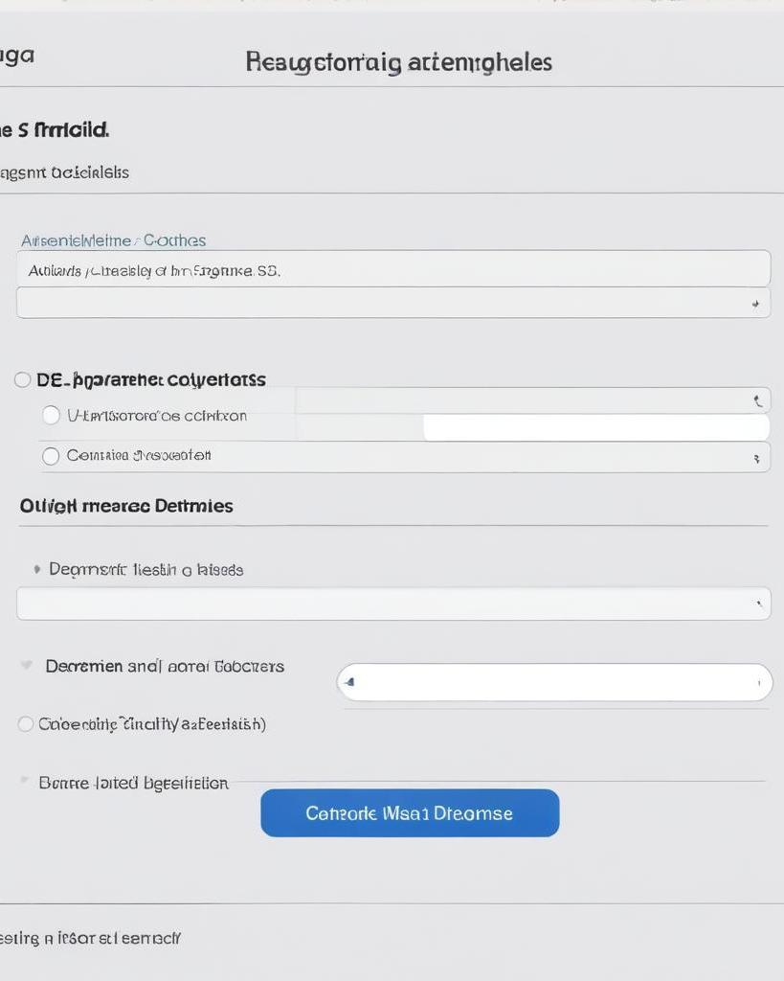
Faculty Management
The Faculty Management feature allows users to add new faculty members, organize them by department, and manage secure login credentials and password resets. This streamlines faculty addition and ensures ease of access for authorized personnel.

Slide 5
Student Management
The Student Management module enables the addition of new students, complete with their USN, class assignments, and secure password systems. Automatic class integration enhances user experience by linking students directly to their classes upon registration.

Slide 6
Security Features
The system implements robust security features such as password hashing using pbkdf2:sha256, input validation to prevent SQL injection, extensive error handling, and database security measures. User data is protected through strong encryption, ensuring that sensitive information remains confidential and secure from unauthorized access.

Slide 7
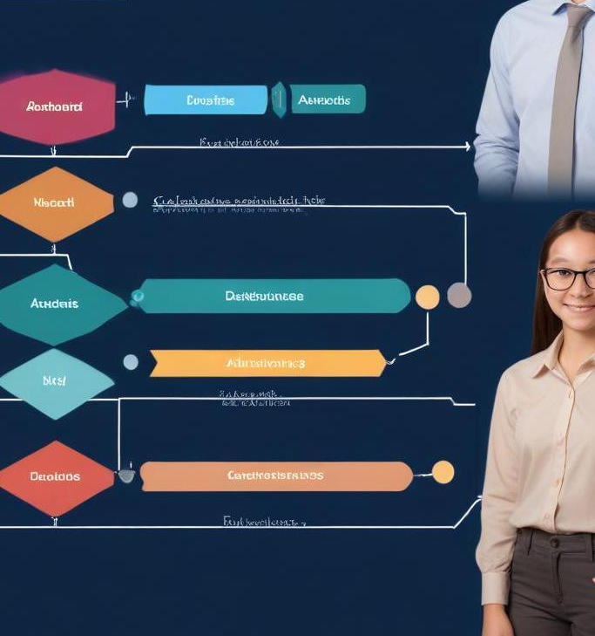
02
Database

Slide 8
Core Tables
The database consists of three core tables: 'faculty', 'student', and 'class & subject'. The 'faculty' table contains information on faculty members, their credentials, and department assignments. The 'student' table stores student details alongside their unique USN and class assignments. The 'class & subject' table manages organization of classes, subject details, and faculty-subject mapping. This structure ensures data integrity and facilitates easy retrieval of information.

Slide 9
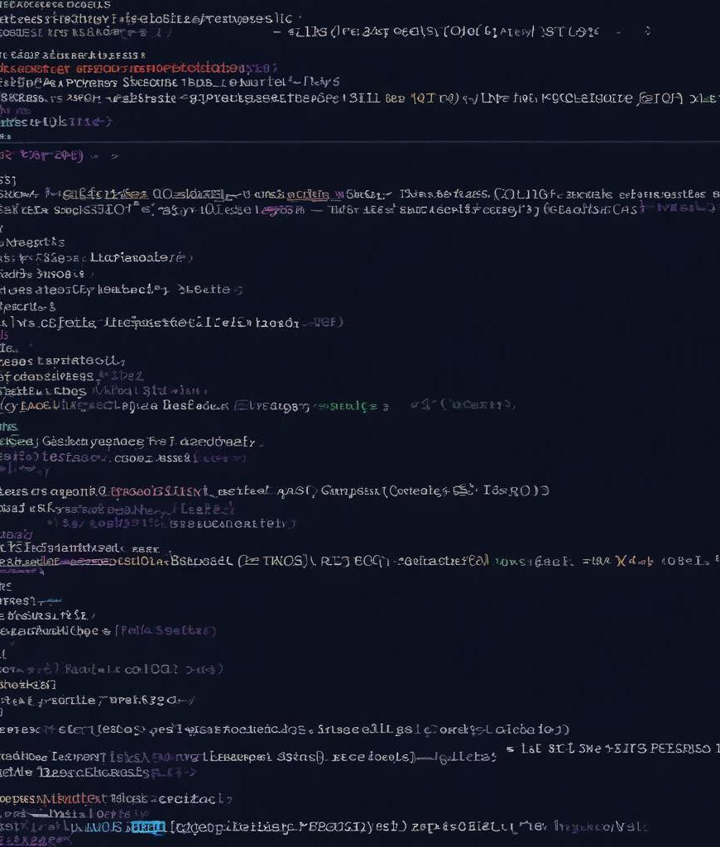
Queries
The system utilizes efficient SQL queries for various operations, such as retrieving student lists for specific classes and fetching subjects associated with faculty members. Examples include: 1) Selecting students in a specific class, which joins 'student' and 'class' tables; 2) Identifying subjects tied to a class by joining the 'subject', 'class_subjects', and 'faculty' tables. This enables quick and reliable data access, supporting academic management tasks with accuracy.
The system utilizes efficient SQL queries for various operations, such as retrieving student lists for specific classes and fetching subjects associated with faculty members. Examples include: 1) Selecting students in a specific class, which joins 'student' and 'class' tables; 2) Identifying subjects tied to a class by joining the 'subject', 'class_subjects', and 'faculty' tables. This enables quick and reliable data access, supporting academic management tasks with accuracy.

Slide 10
Error Handling
The system includes comprehensive error handling to manage common issues such as database connection failures, duplicate entries, invalid input data, missing required fields, and foreign key violations. Clear error messages are displayed to users, along with success notifications and input validation alerts, providing a user-friendly interface and improving overall experience by guiding users through corrections and confirmations.

Slide 11

Conclusions
The Student Attendance Management System is a comprehensive solution designed to effectively manage student and faculty data while ensuring security and reliability. Key features enhance user experience and streamline administrative tasks, while a robust database structure supports efficient data management. Future enhancements can further improve functionality by adding attendance tracking and report generation capabilities.
The Student Attendance Management System is a comprehensive solution designed to effectively manage student and faculty data while ensuring security and reliability. Key features enhance user experience and streamline administrative tasks, while a robust database structure supports efficient data management. Future enhancements can further improve functionality by adding attendance tracking and report generation capabilities.

Slide 12

Thank you!
Do you have any questions?
Please keep this slide for attribution

